Slide 1

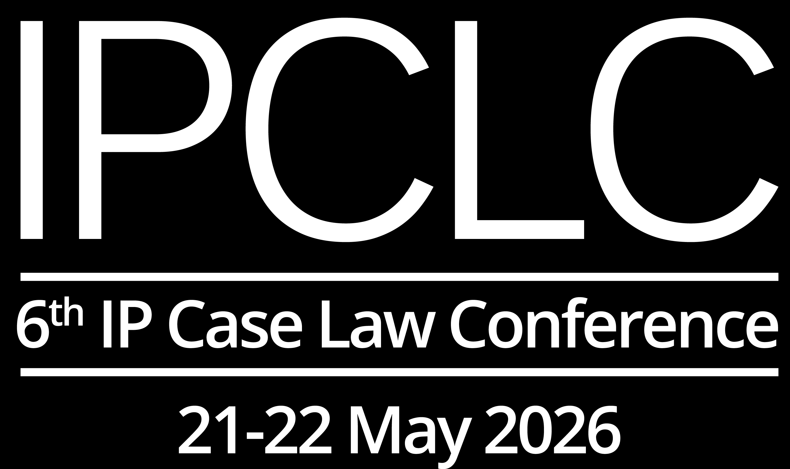
Is ‘high inherent distinctiveness’ an oxymoron?
Cinzia Negro
Chairperson of the Second Board of Appeal

Slide 2
Is ‘high inherent distinctiveness’ an oxymoron?
Likelihood of Confusion
scenario
8(1)(b) EUTMR

Slide 3
The principle…
11/11/1997, C‑251/95, Sabèl, § 24
In that perspective, the more distinctive the earlier mark, the greater will be the likelihood of confusion. It is therefore not impossible that the conceptual similarity resulting from the fact that two marks use images with analogous semantic content may give rise to a likelihood of confusion where the earlier mark has a particularly distinctive character, either per se or because of the reputation it enjoys with the public.
29/09/1998, C‑39/97, Canon, § 18
Since the more distinctive the earlier mark, the greater will be the likelihood of confusion, marks with a highly distinctive character, either per se or because of the reputation they possess on the market, enjoy broader protection than marks with a less distinctive character.
22/06/1999, C‑342/97, Lloyd Schuhfabrik, § 20
Furthermore, the more distinctive the earlier mark, the greater will be the likelihood of confusion (SABEL, paragraph 24), and therefore marks with a highly distinctive character, either per se or because of the recognition they possess on the market, enjoy broader protection than marks with a less distinctive character (Canon, paragraph 18).

Slide 4
… and its limits
16/05/2013, C 379/12 P, H.Eich / SILVIAN HEACH (fig.), § 71
Furthermore, it must be noted that, although according to EU case-law, trade marks with a high degree of inherent distinctiveness enjoy broader protection than trade marks with a lesser degree of distinctiveness (see judgment of 22 June 1999, Lloyd Schufabrik Meyer, C‑342/97, ECR p. I-3819, paragraph 20 and the case-law cited), there is, on the other hand, no rule to the effect that the absence of a conceptual link between the trade mark and the goods or services covered by it automatically confers on that trade mark a strong inherent distinctiveness such as to afford it broader protection.

Slide 5
What about invented terms? Are they ‘highly inherently distinctive’?
No automatic rule for
no conceptual link with the G&S = high inherent distinctiveness
What more would be needed?
evidence of extensive use? → NO: it would no longer be inherent
invented term?
(or a highly original composite or figurative mark)
?

Slide 6
Answer seems negative: General Court
03/12/2025, T‑617/24, nooka your space (fig.) / NOKIA et al., § 63
In the present case, it is common ground that the word ‘nokia’ does not, as such, have any meaning in relation to the goods and services concerned. However, contrary to what the applicant claims, it cannot be inferred from that fact alone that the earlier mark has a relatively high degree of inherent distinctiveness. The Board of Appeal was therefore correct in finding that the inherent distinctive character of that mark was normal in respect of the goods and services concerned.
15/11/2023, T‑19/23, NORMOCARE / NOMOR, § 30
Furthermore, it is not disputed that the earlier mark has no meaning for the relevant public, which will perceive it as an invented term with a normal distinctive character in relation to the goods in question

Slide 7
Answer seems negative: EUIPO Boards of Appeal
22/04/2026, R 1825/2025-2, ROUA Apusenilor (fig.) / APUSEANA (fig.), § 54
Contrary to the opponent’s view, a trade mark will not have a higher degree of distinctive character just because there is no conceptual link to the relevant goods (…) or because it has no meaning in the relevant territory (…). When an earlier mark is not descriptive (or is not otherwise non-distinctive), it will be deemed as having no more than a normal degree of inherent distinctiveness. The degree of distinctiveness can be further enhanced if appropriate evidence is submitted showing a higher degree of distinctiveness acquired through use. This is not the case here.
27/06/2019, R 2349/2018-4, Toscale / Outscale et al, § 35, 37
There is no rule to the effect that the absence of a conceptual link between the trade mark and the goods or services concerned automatically confers on that trade mark a high degree of inherent distinctiveness (…) The ‘OUTSCALE’ trade mark possesses inherent distinctiveness, given that, taken as a whole, it is neither descriptive nor allusive or laudatory in relation to the goods and services.

Slide 8
Conclusion in Likelihood of Confusion scenario – 8(1)(b) EUTMR
Earlier mark: common (arbitrary) word Made up case | Earlier mark: invented (fanciful) word Made up case
NOVELLA vs TALMELLA Class 30 Class 30 | TALMELLA vs NOVELLA Class 30 Class 30
No likelihood of confusion | No likelihood of confusion
Same result → Common words with no conceptual link to the G&S and invented words have the same scope of protection
→ if the earlier mark has no connection with the G&S and is not known to the public, it has average inherent distinctiveness, whether it is a common word or an invented one
→ Is high inherent distinctiveness an oxymoron? YES

Slide 9
Is ‘high inherent distinctiveness’ an oxymoron?
Unfair advantage / Detriment
to Reputation scenario
8(5) EUTMR

Slide 10
The principle…
27/11/2008, C‑252/07, Intel
The stronger the distinctive character of the earlier mark, whether inherent or acquired through the use which has been made of it, the more likely it is that, confronted with a later identical or similar mark, the relevant public will call that earlier mark to mind (§ 54)
In so far as a trade mark’s distinctive character is all the stronger if that mark is unique – that is to say, as regards a word mark such as INTEL, if the word of which it consists has not been used by anyone for any goods or services other than by the proprietor of the mark for the goods and services it markets – it must be ascertained whether the earlier mark is unique or essentially unique (§ 56)
The more ‘unique’ the earlier mark appears, the greater the likelihood that the use of a later identical or similar mark will be detrimental to its distinctive character (§ 74).

Slide 11

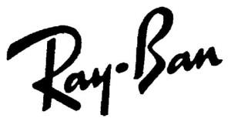
… and its application
21/12/2022, T‑4/22, PUMA (fig.) / PUMA (fig.) et al., § 66
The applicant has not demonstrated that the affixing of the mark applied for, PUMA, in the specific commercial context of the goods covered by that mark, would bring the earlier mark to mind (…) the standard of proof required in this case is higher, since the earlier mark is composed not of a fanciful name but of a common noun which primarily designates an animal
08/05/2018, T‑721/16, BeyBeni (fig.) / Ray-Ban (fig.) et al., § 86
A ‘unique mark’ exerts an evocative power over the public and the more immediate and strong the evocation of the earlier mark by the later mark, the greater the risk that the current or future use of the later trade mark will take unfair advantage of the distinctive character or reputation of the earlier trade mark or that such use will be detrimental to that distinctive character or reputation

Slide 12

Conclusion in Reputation scenario – 8(5) EUTMR
Earlier mark: common (arbitrary) word Real case | Earlier mark: invented (fanciful) word → unique Made up case
vs | vs Ray-Ban
No link | Link?
Class 25
Class 7 - Lathes; electric
discharge machine; …
Class 7 - Lathes; electric discharge machine; …
Class 9
Very high reputation
Very high reputation
Different result ? → A unique mark is more readily and strongly evoked in the mind of consumers than a common (albeit arbitrary) word.
All else being equal (almost identical marks, very high reputation and no conceptual connection with the goods) it is easier for a unique trade mark to come to the consumer’s mind when encountered on completely different products.
→ Is high inherent distinctiveness an oxymoron? NO – provided it is framed as ‘uniqueness’

Slide 13
THANK YOU

